Slide 1
The Importance of Strong IP to Inventors, Startups and Their Investors
Exposing the False Narrative and the True Agenda of Patent Reform
Charles Giancarlo
Chair, USIJ

Slide 2
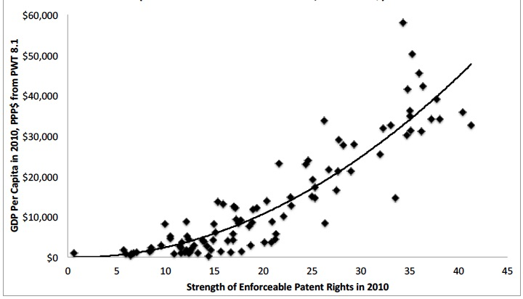
The Relationship Between Enforceable Patent Rights And GDP Per Cap In 2010*
* Excludes Oil-based Economies
Source: Haber: “Patents and the Wealth of Nations”

Slide 3
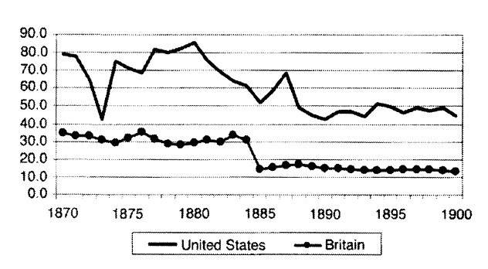
The Ratio Of All Assignments And Licenses To Patents US & Britain, 1870-1900
Source: Kahn & Solokoff: “Institutions and Democratic Invention in 19th-Century America: Evidence from "Great Inventors," 1790-1930”

Slide 4
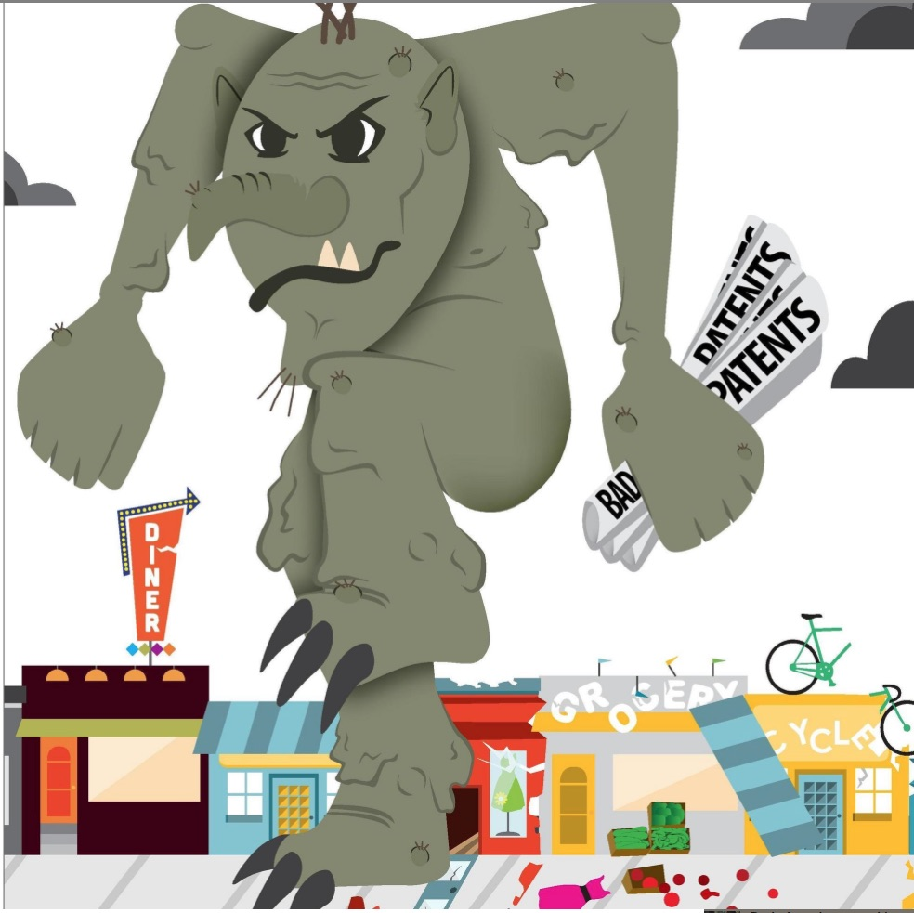
Politico Sponsored Cartoon

Slide 5
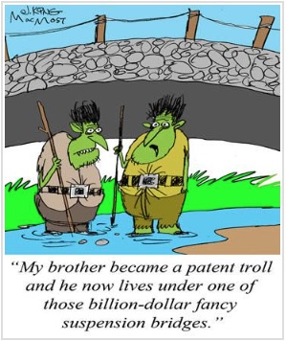

Slide 6
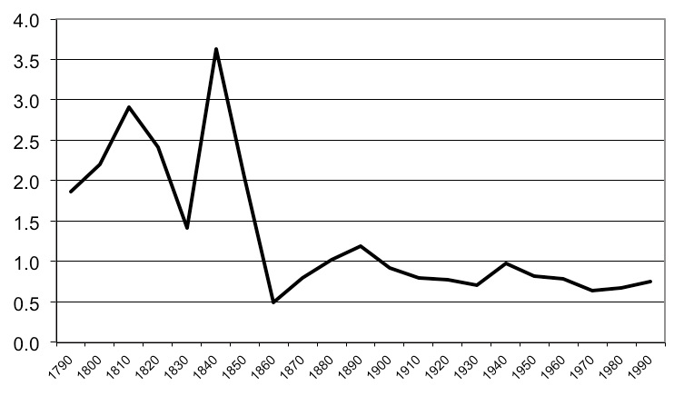
Patent Litigation Rates (1790-2000) (by decade)
Source: Khan: “Trolls And Other Patent Inventions: Economic History And The Patent Controversy In The Twenty-first Century”

Slide 7
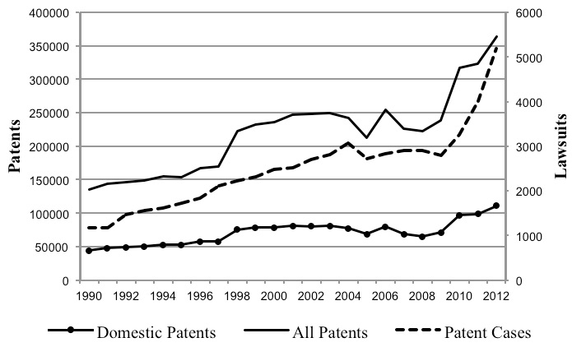
Patent Litigation, Relative To Total And Domestic Patent Grants (1990-2012)
Source: Khan: “Trolls And Other Patent Inventions: Economic History And The Patent Controversy In The Twenty-first Century”

Slide 8
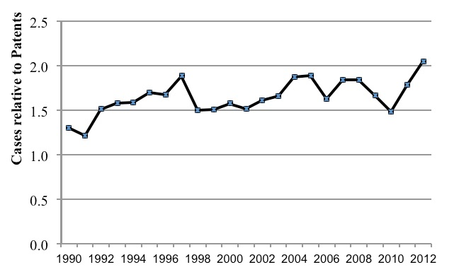
Patent Litigation Rates (1990-2012)
Source: Khan: “Trolls And Other Patent Inventions: Economic History And The Patent Controversy In The Twenty-first Century”

Slide 9
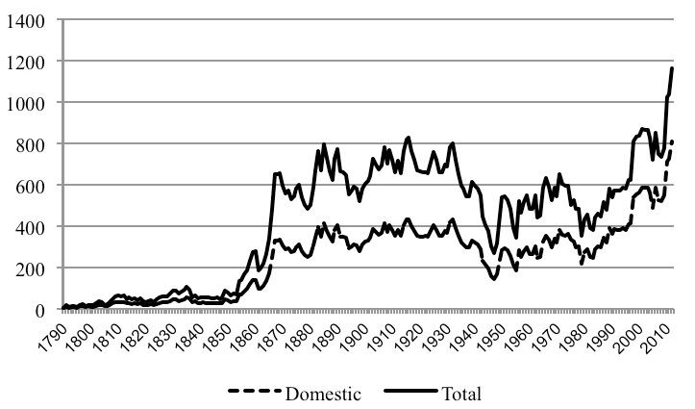
U.S. Patenting Rates pp (1790-2012)
Source: Khan: “Trolls And Other Patent Inventions: Economic History And The Patent Controversy In The Twenty-first Century”

Slide 10
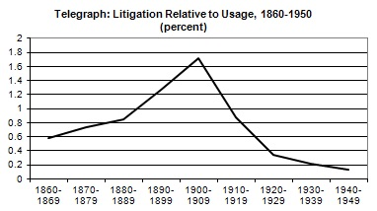
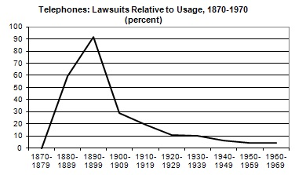
Total Civil Litigation % (Major Innovations)
Source: Khan: “Trolls And Other Patent Inventions: Economic History And The Patent Controversy In The Twenty-first Century”

Slide 11
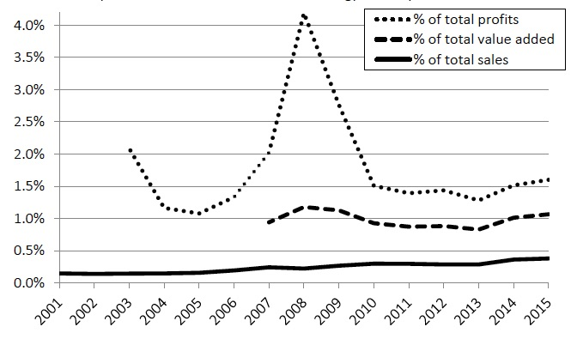
Publicly-traded PAE Revenue As % Of Technology Industry, 2001-15
Source: Maurer and Haber: “Patent Trolls or Patent Elves? Evidence from Publicly-Traded Patent Assertion Entities.”

Slide 12
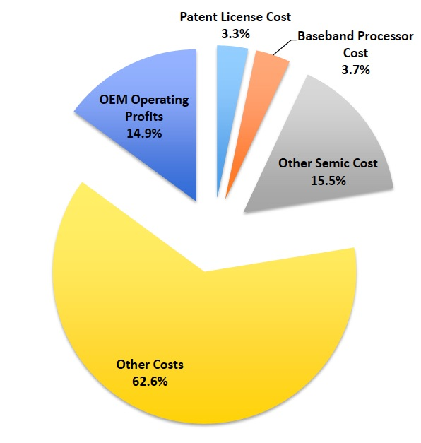
Mobile Phone Economics (2015)
Source: Galetovic, Haber and Zaretzki: “Is There an Anti-Commons Tragedy in the Smartphone Industry? Working Paper # 17005.”

Slide 13
“This academic study says that Patent Trolls are making mobile phones unaffordable for Americans!”

Slide 15
Thank You!
Charles Giancarlo Chair, USIJ
USIJ@giancarlo.org

